Slide 1
TR-103 TRAINING Semantic Web
Submitted By: Rahul Kumar
URN:2104162

Slide 2
Semantic Web
Understanding the concept of the Semantic Web is essential for modern web development. The Semantic Web aims to make web data machine-readable, enhancing data findability, shareability, and integration. This concept emphasizes the importance of creating a web where data can be easily accessed and interpreted by machines, enabling more intelligent and efficient data use. One of the fundamental frameworks for the Semantic Web is the Resource Description Framework (RDF). RDF is used to represent information about web resources, ensuring data interoperability across different systems and applications. It achieves this by using a graph form to represent information, where nodes signify entities or resources, edges (predicates/properties) depict relationships between entities, and literals represent values like strings or numbers.

Slide 3
HTML & CSS
The exploration of HTML and CSS began with an insightful look into their pivotal roles in web development and the essential syntax of each language. HTML, or Hypertext Markup Language, forms the backbone of web content, structuring and defining elements on a webpage. CSS, or Cascading Style Sheets, is crucial for styling these HTML elements, enhancing visual appeal and user experience. Together, HTML and CSS are fundamental in creating and designing web pages, making them indispensable for web developers.

Slide 4
Use of RDF & Graphs
The Resource Description Framework (RDF) is a crucial component of the Semantic Web, providing a framework for representing information about web resources. It ensures data interoperability across different systems and applications, enabling diverse systems to understand and use data consistently. RDF represents information in a graph form, where nodes represent entities or resources, edges (predicates/properties) indicate relationships between entities, and literals represent values like strings or numbers. This graph structure is particularly intuitive for modelling complex data. The basic unit of RDF is the RDF-triple, which consists of three parts: subject, predicate, and object. The subject is the resource being described, the predicate is the property or relationship of the resource, and the object is the value of the property or another related resource. A practical exercise involved developing an RDF for online shopping, offering hands-on experience in applying RDF concepts and fostering collaboration and problem-solving skills

Slide 5
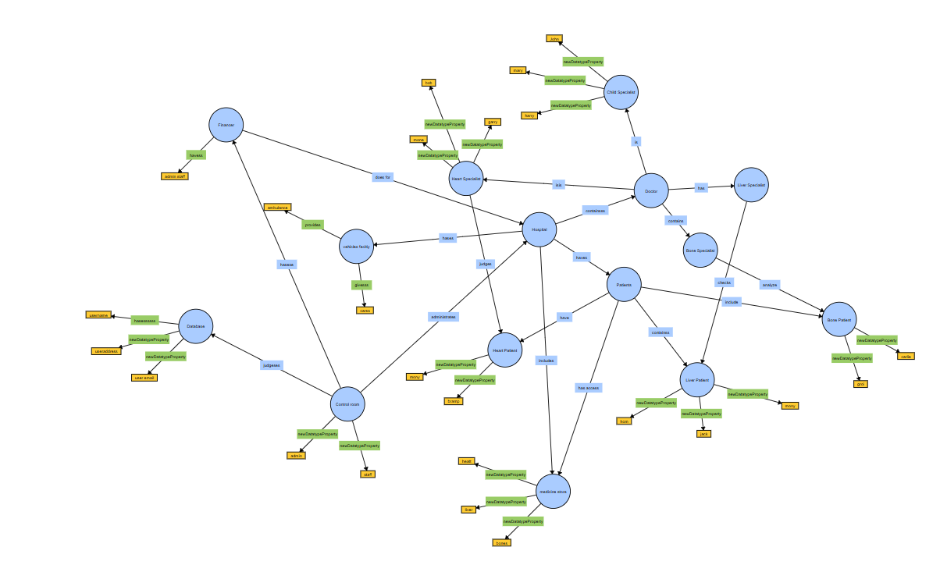

Slide 6
Tools
We delved into several essential tools integral to web development and semantic web technologies, each offering unique functionalities that contribute to the efficiency, accessibility, and overall quality of web projects. The exploration of these tools provided a comprehensive understanding of their applications and benefits, equipping us with the skills necessary to leverage them effectively in real-world scenarios. SPARQL, the SPARQL Protocol and RDF Query Language, is a powerful and flexible query language specifically designed for querying and manipulating RDF (Resource Description Framework) data. SPARQL allows for the retrieval and manipulation of data stored in RDF format, making it possible to perform complex queries across diverse datasets. Its capability to query interconnected data across different sources is crucial in the Semantic Web, where data interoperability and integration are key.

Slide 7
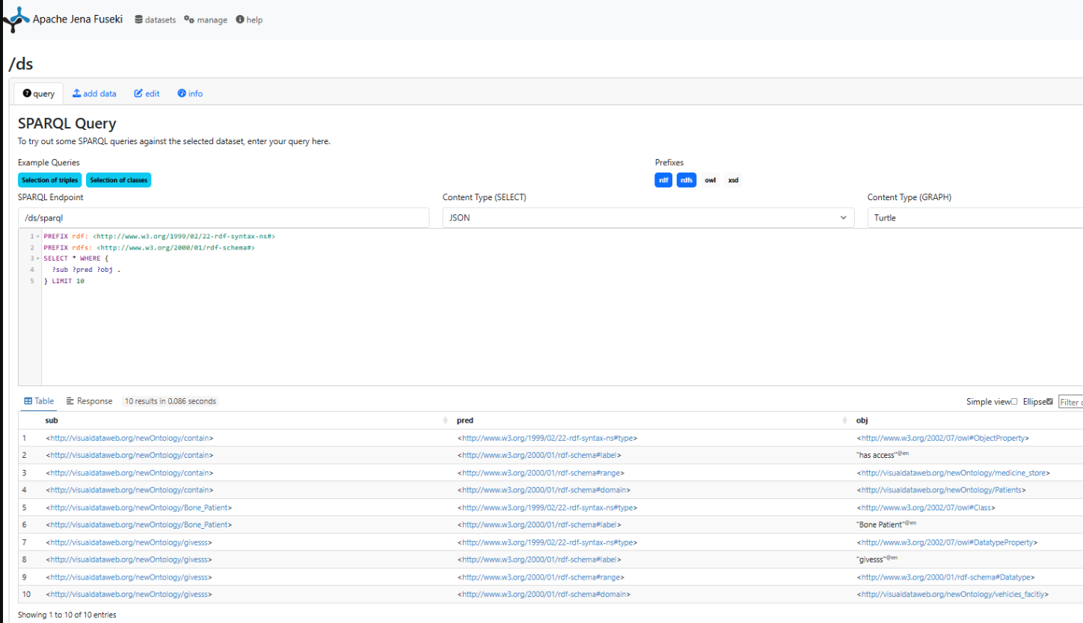

Slide 8
Training Work
We delved deeply into HTML (Hypertext Markup Language) and CSS (Cascading Style Sheets), two foundational technologies crucial for creating and styling web pages. This immersive learning experience offered attendees a thorough understanding of both languages, covering their syntax, structure, and practical applications in building efficient, visually appealing, and well-organized websites. We began with a detailed study of HTML, the backbone of web content. HTML provides the basic structure of websites, allowing developers to define and organize content through various elements and tags.
for paragraphs were explored in depth. Hands-on exercises reinforced these concepts, enabling participants to practice writing basic HTML code and gaining confidence in creating structured web pages.

Slide 9
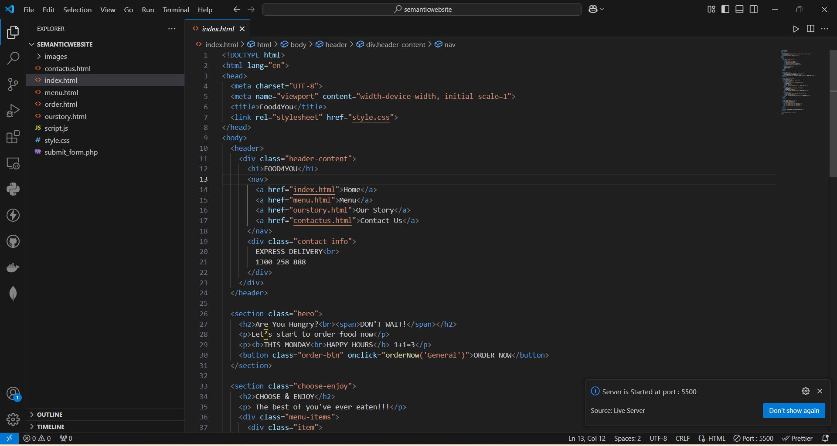

Slide 10
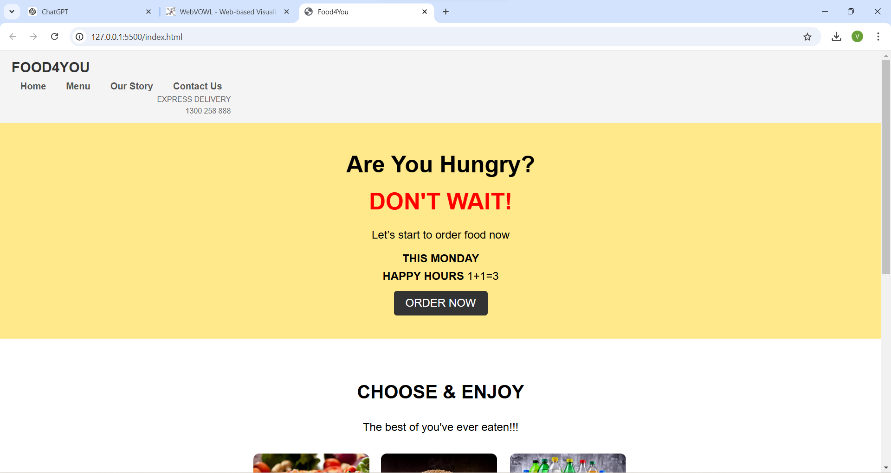

Slide 11
RDF,JSON,XML
During our exploration of web technologies, we examined RDF (Resource Description Framework), JSON (JavaScript Object Notation), and XML (extensible Markup Language), appreciating their critical roles in data representation, interchange, and integration across diverse web applications. These technologies form the backbone of the Semantic Web, enabling structured data to be shared, linked, and utilized coherently. RDF plays a fundamental role in representing information about web resources. It allows data to be described in a machine-readable and semantically rich format using a graph-based data model. In this model, nodes represent entities or resources, edges (predicates/properties) represent relationships between entities, and literals represent values such as strings or numbers.

Slide 12
SPARQL/APACHE JENA FUSEKI
To begin working with Apache Jena Fuseki, the initial step was to download the software. This was accomplished by visiting the official Apache Jena website at jena.apache.org. Once there, I navigated to the download section specifically for Fuseki and selected the latest stable release version for optimal performance and compatibility. OpenJDK. To upload data over Apache Jena Fuseki, I started by navigating to the directory where Fuseki was extracted and ran the server using the command. /fuseki-server on Linux. After starting the Fuseki server, I accessed the Fuseki user interface by opening a web browser and going to http://localhost:3030. To create a dataset, I clicked on "Datasets," then "Add new dataset," entered a name, and selected the dataset type (e.g., in-memory or TDB). To upload RDF data, I 39 selected the newly created dataset, went to the "Upload" tab, chose the RDF data file from my local machine, and clicked "Upload" to load the data into the dataset.

Slide 14
Skills Developed
Understanding of RDF, OWL, and SPARQL standards.
Proficiency in creating and querying RDF datasets.
Knowledge of ontology modelling and design using OWL.
Ability to use semantic web tools like Protégé and Apache Jena.
Competence in linking and integrating data from diverse sources.
Skills in data visualization and interpretation.
Experience with RDF serialization formats (RDF/XML, Turtle, N-Triples).
Familiarity with semantic web applications and use cases.
Enhanced problem-solving and analytical thinking abilities.
Development of user-friendly interfaces for semantic web tools.

Slide 15
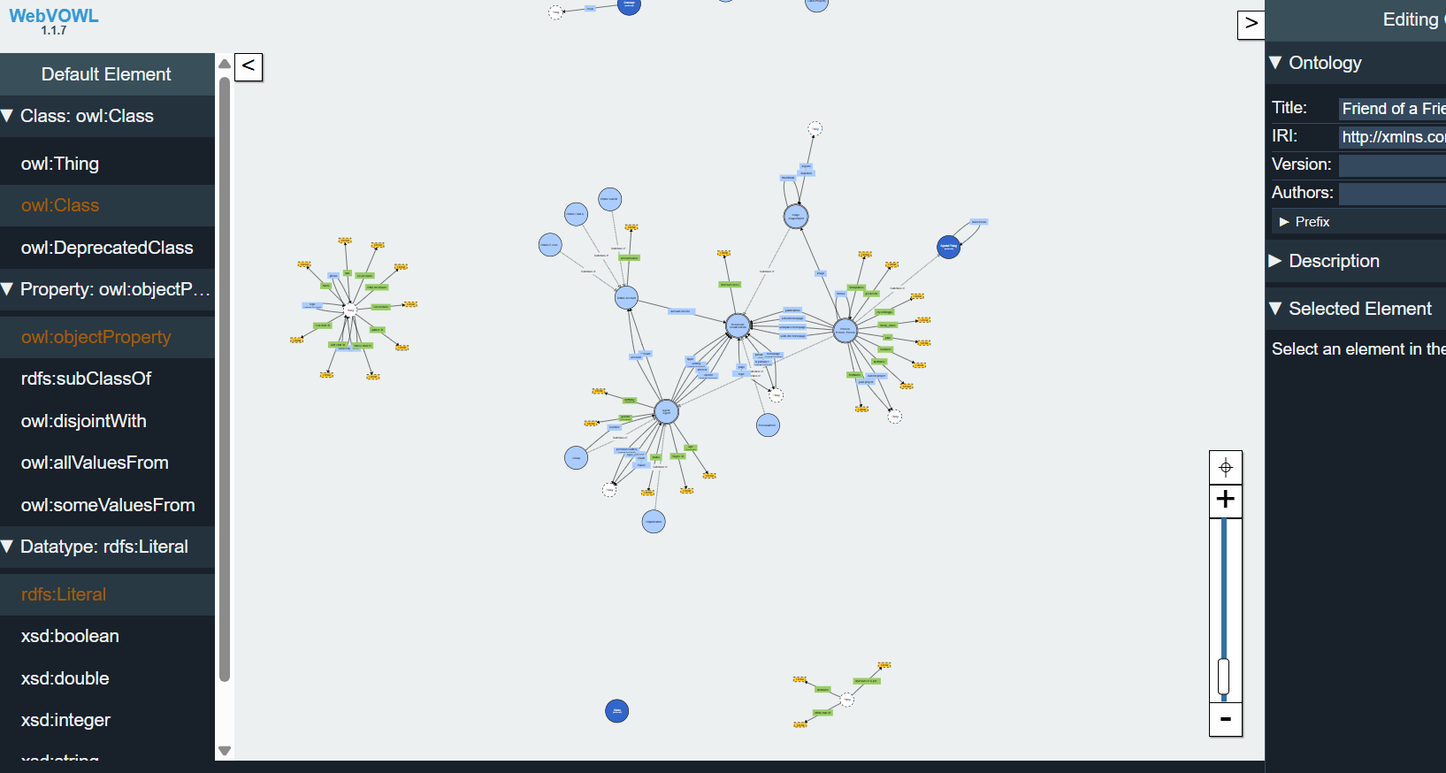

Slide 16
Conclusion
The training in Semantic Web has been instrumental in equipping participants with a robust foundation in essential concepts and technologies crucial for modern web development and data management. Throughout the program, participants delved into fundamental topics such as RDF (Resource Description Framework), OWL (Web Ontology Language), SPARQL (SPARQL Protocol and RDF Query Language), JSON (JavaScript Object Notation), XML (extensible Markup Language), and advanced tools like FeusiKI. The training sessions provided a structured approach to understanding RDF, which forms the backbone of Semantic Web data representation, enabling participants to grasp how to describe resources and their relationships in a standardized format.

Slide 17
Future Scope
Semantic Web technologies are poised to revolutionize data management and web development in the coming years. With increasing volumes of data being generated daily, these technologies offer a robust framework for organizing, linking, and extracting meaningful insights from diverse datasets. Future advancements may see the emergence of more intelligent applications that leverage ontologies and semantic relationships to enhance automation, personalization, and decision-making processes across various sectors. Enhanced interoperability facilitated by RDF, OWL, and JSON will enable seamless integration of data from disparate sources, fuelling innovations in AI-driven knowledge graphs, semantic search engines, and dynamic content delivery systems.

Slide 18
THANK you!

